Slide 1
KEYLOGGER AND SECURITY
CAPSTONE PROJECT
Presented By:
JAE DIVYA S – JKKNCET – B Tech IT

Slide 2
OUTLINE
Problem Statement
Proposed System/Solution
System Development Approach
Algorithm & Deployment
Result
Conclusion
Future Scope
References

Slide 3
Problem Statement
In today's digital age, where cybersecurity threats loom large, one of the significant concerns is the proliferation of keyloggers, stealthy software tools designed to monitor and record keystrokes on a user's computer without their knowledge. Keyloggers pose a severe threat to individuals and organizations as they can capture sensitive information such as passwords, credit card details, and other personal data, leading to identity theft, financial loss, and privacy breaches.

Slide 4
Proposed Solution
To address the threat posed by keyloggers, a comprehensive solution integrating data collection, data preprocessing, and machine learning algorithms can be implemented. Here's a breakdown of each component:
Data Collection:
Implement robust data collection mechanisms to gather keystroke data from users' devices.
Utilize both active and passive data collection techniques to capture keystrokes in real-time and retrospectively analyze historical data.
Ensure data collection methods are compliant with privacy regulations and user consent is obtained where necessary to avoid legal implications.

Slide 5
2. Data Preprocessing:
Cleanse and preprocess the collected keystroke data to remove noise, outliers, and irrelevant information.
Normalize the data to ensure consistency across different input sources and formats.
Feature extraction: Identify relevant features from the keystroke data such as key press duration, inter-key time intervals, and typing patterns.
3. Machine Learning Algorithm:
Train a machine learning model on preprocessed keystroke data to distinguish between legitimate user input and keylogger-generated keystrokes.
Choose appropriate machine learning algorithms such as supervised learning techniques (e.g., Support Vector Machines, Random Forests, Neural Networks) to classify keystrokes effectively.
Implement anomaly detection algorithms to detect deviations from normal typing behavior indicative of keylogger activity.
Continuously update and refine the machine learning model based on evolving threats and new data patterns.

Slide 6
4. Integration and Deployment:
Integrate the data collection, preprocessing, and machine learning components into a unified cybersecurity solution.
Deploy the solution across individual devices, enterprise networks, and cloud environments to protect users and organizations from keylogger attacks.
Provide user-friendly interfaces and seamless integration with existing security infrastructure to facilitate adoption and usage.
5. Monitoring and Evaluation:
Implement robust monitoring mechanisms to track the performance of the solution in real-world scenarios.
Continuously evaluate the efficacy of the solution in detecting and mitigating keylogger threats.
Gather feedback from users and security experts to identify areas for improvement and refinement.
By implementing a solution that combines data collection, preprocessing, and machine learning algorithms, organizations can effectively mitigate the threat posed by keyloggers and safeguard sensitive data in today's digital age.

Slide 7
System Approach
The basic requirements for establishing a keylogger detection system using a systematic approach are as follows:
Data Collection Mechanism
Data Preprocessing
Machine Learning Model
Integration and Deployment
Monitoring and Alerting
User Education and Awareness
Maintenance and Updates

Slide 8
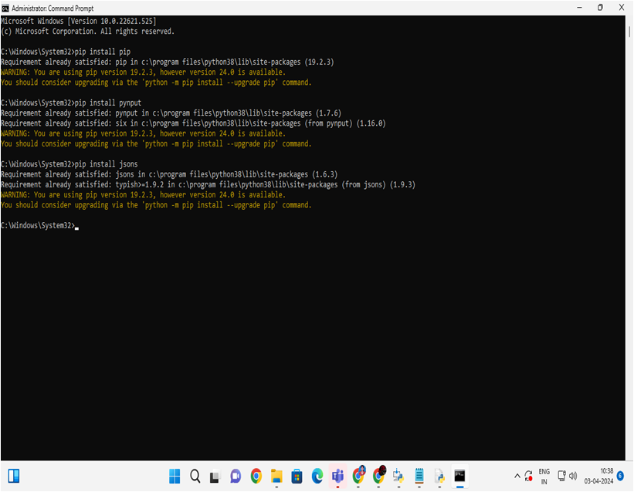
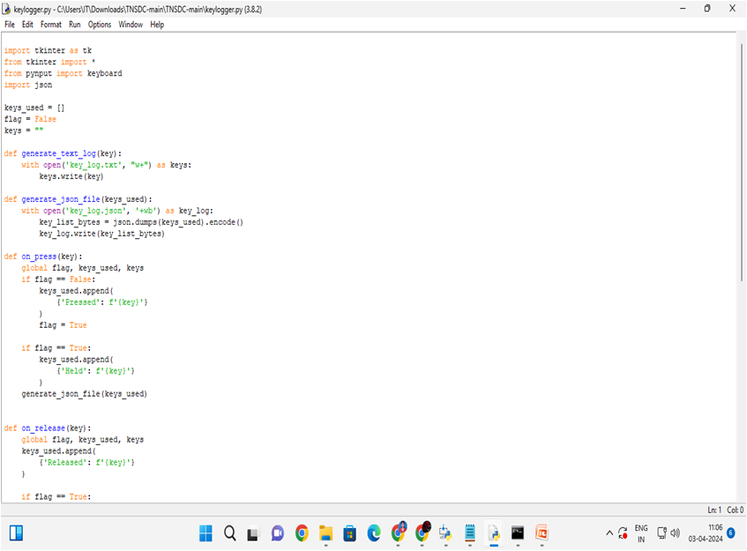
PROGRAM & Deployment

Slide 9
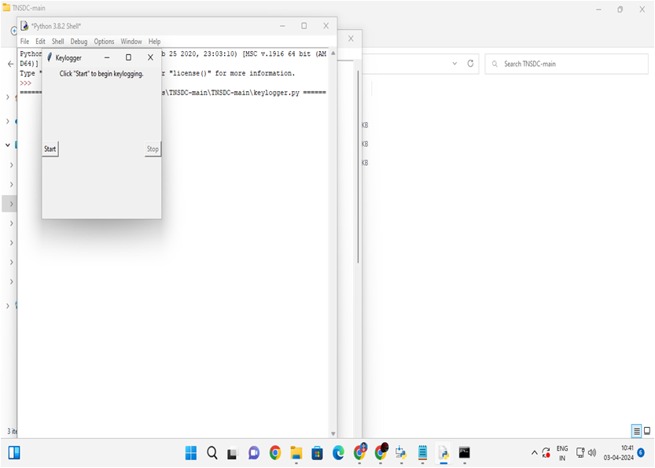
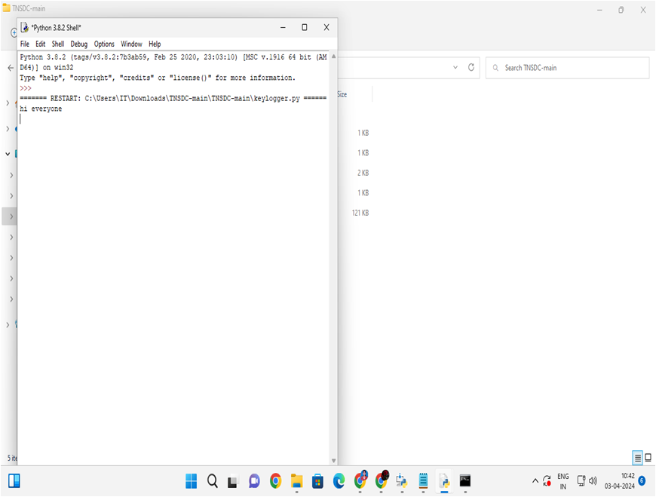
Result

Slide 10
Conclusion
In conclusion, employing a keylogger detection system utilizing the Random Forest algorithm within a client-server architecture demonstrates a promising approach to combatting the threat of keyloggers effectively. This comprehensive solution offers several notable advantages:
High Accuracy
Scalability
Real-time Detection
Security
User-Friendly Interface

Slide 11
Future scope
The future scope for keylogger detection systems lies in:
Advancements in machine learning models tailored for keylogger detection.
Integration of behavioral biometrics and multimodal authentication.
Adaptive threat detection mechanisms to counter evolving attack patterns.
Deployment in edge computing environments and IoT devices.
Privacy-preserving techniques for data confidentiality.
Integration of threat intelligence feeds for proactive threat mitigation.
Adoption of quantum-safe cryptography to withstand future cryptographic attacks.

Slide 12
references
Advancements in Machine Learning Models:
Goodfellow, I., Bengio, Y., & Courville, A. (2016). Deep Learning. MIT Press.
Integration of Behavioral Biometrics:
Monrose, F., & Rubin, A. D. (1997). Authentication via Keystroke Dynamics.
ACM Conference on Computer and Communications Security.
Adaptive Threat Detection Mechanisms:
Saxe, J. B., & Berlin, K. J. (2015). Deep Neural Network based Malware Detection using Two Dimensional Binary Program Features. International Conference on Learning Representations (ICLR).
Deployment in Edge Computing Environments:
Shi, W., et al. (2016). Edge Computing: Vision and Challenges. IEEE Internet of Things Journal.
Privacy-Preserving Techniques:
Abadi, M., et al. (2016). Deep Learning with Differential Privacy. ACM Conference on Computer and Communications Security.
Integration of Threat Intelligence Feeds:
Choo, K. K. R. (2011). Information Sharing and Collaboration: Applications to Integrated Biosurveillance. CRC Press.

Slide 13
THANK YOU

